Slide 1
THE INDUCTIVE (EVIDENTIAL) VERSION OF THE ARGUMENT FROM
EVIL
WILLIAM ROWE

Slide 2
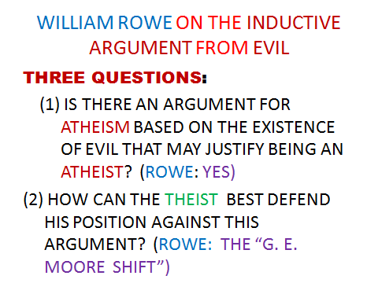

Slide 3
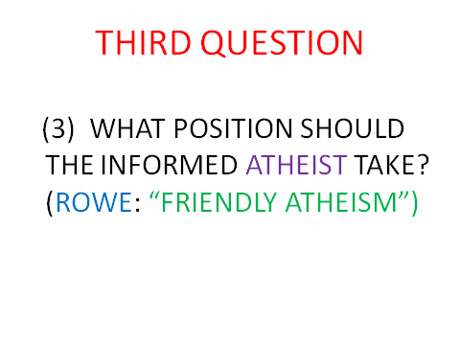

Slide 4
SOME DISTINCTIONS: TWO KINDS OF THEISM
NARROW THEISM: “THERE IS AN OMNIPOTENT, OMINISCIENT, ETERNAL, SUPREMELY GOOD BEING WHO CREATED THE UNIVERSE.”
BROAD THEISM: “THERE IS SOME SORT OF DIVINE BEING OR DIVINE REALITY”

Slide 5
TWO KINDS OF GOOD (BAD) [NOT MENTIONED BY ROWE]
INTRINSIC GOODNESS: A situation is intrinsically good if, considered all by itself, it would be a good thing.
CONSEQUENTIAL GOODNESS: A situation is consequentially good if it leads to good results.

Slide 6
SUFFERING & JOY
INTRINSICALLY BAD: UNWANTED, INTENSE, AND
PROLONGED PAIN.
INTRINSICALLY GOOD: INTENSE,
PROLONGED
JOY.

Slide 7
ROWE’S STATEMENT OF THE (INDUCTIVE) ARGUMENT FROM EVIL
There exist instances of intense suffering which an omnipotent, omniscient being could have prevented without thereby losing some greater good or permitting some evil equally bad or worse.
(2) An omniscient, wholly good being would prevent the occurrence of any intense suffering it could , unless it could not do so without thereby losing some greater good or permitting some evil equally bad or worse.

Slide 8
CONCLUSION
There does not exist an omnipotent, omniscient, wholly good being.
THIS IS ONLY PART OF THE ARGUMENT. IS THIS PART DEDUCTIVELY VALID?

Slide 9
ROWE’S EVALUATION OF THE ARGUMENT (QUESTION 1: “YES”)
THE ARGUMENT IS DEDUCTIVELY VALID AND THE SECOND PREMISE IS QUITE REASONABLE. (p. 110)
THE FIRST PREMISE IS REASONABLE AS WELL (pp. 111-112)
There is an inductively strong argument from evidence that we have that the first premise is true.

Slide 10
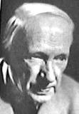
QUESTION 2: “THE G. E. MOORE SHIFT”

Slide 11
MOORE’S USE OF THE “G. E. MOORE SHIFT”: SKEPTICISM
I do know that this pencil exists.
If the skeptic’s principles are correct, I cannot know of the existence of this pencil.
Therefore:
(3) The skeptic’s principles (at least one) must be incorrect.

Slide 12
GENERAL STRATEGY OF THE SHIFT
I. P
Q
Therefore : R
Not-R
Q
Therefore: Not-P

Slide 13
LEIBNIZ VS. VOLTAIRE: THE SHIFT APPLIED TO A DEDUCTIVE VERSION OF THE ARGUMENT FROM EVIL
(1) God exists.
If God exists, He is omnipotent, omniscient, and all good.
An omniscient, omnipotent, all-good being would create the best possible world.
Therefore:
(4) This is the best possible world.

Slide 14
VOLTAIRE’S SHIFT
If God exists, He is omnipotent, omniscient, and all good.
An omniscient, omnipotent being, all-good being would create the best possible world.
(4’) This is NOT the best possible world.
Therefore,
(1’) God does NOT exist.

Slide 15
THE THEIST’S APPLICATION OF THE SHIFT
(NOT-3) There DOES exist an omnipotent, omniscient, wholly good being.
(2) An omniscient, wholly good being would prevent the occurrence of any intense suffering it could , unless it could not do so without thereby losing some greater good or permitting some evil equally bad or worse.

Slide 16
THEIST’S CONCLUSION AFTER THE SHIFT
(NOT-1) There DO NOT exist instances of intense suffering which an omnipotent, omniscient being could have prevented without thereby losing some greater good or permitting some evil equally bad or worse.

Slide 17
ROWE’S EVALUATION
PREMISE (1) OF THE INDUCTIVE ARGUMENT FROM EVIL IS MORE REASONABLE THAN PREMISE (NOT-3) OF THE THEIST’S SHIFT-ARGUMENT - GIVEN HIS (ROWE’S) EVIDENCE BAS E.
BUT (SAYS ROWE) SOME THEISTS MAY WELL HAVE A REASONABLE BELIEF IN PREMISE (NOT-3) OF THE SHIFT-ARGUMENT (!!!) – GIVEN THEIR (THE THEIST’S) EVIDENCE BASE.

Slide 18
WHAT IS GOING ON HERE?? WHICH ARGUMENT IS BETTER?
THERE IS AN EXTREMELY IMPORTANT POINT TO BE MADE IN ANSWERING THIS QUESTION AND IN EXPLAINING HOW ROWE CAN BE A “FRIENDLY ATHEIST”.

Slide 19
A PRELIMENARY QUESTION
WHY IS THIS CALLED AN INDUCTIVE VERSION OF THE ARGUMENT FROM EVIL? BOTH THIS ARGUMENT AND THE THEIST’S SHIFT-ARGUMENT ARE DEDUCTIVELY VALID (HOW CAN THAT BE? ISN’T A DEDUCTIVELY VALID ARGUMENT THE BEST KIND OF ARGUMENT?)

Slide 20
ANSWER
WHAT MAKE IT APPROPRIATE TO CALL ROWE’S ARGUMENT “INDUCTIVE” IS THAT THE OVERALL ARGUMENT STRUCTURE WOULD INCLUDE AN ARGUMENT FOR PREMISE (1). AND THAT ARGUMENT – BASED ON ROWE’S EVIDENCE BASE AS PREMISES - MAY BE INDUCTIVELY STRONG.

Slide 21
STILL PUZZLING?
EXTREMELY IMPORTANT POINT NO. 1:
PROBABILITY, AND, HENCE, RATIONALITY OR REASONABILITY, IS RELATIVE. (TRUTH IS NOT RELATIVE).

Slide 22
THE REQUIREMENT OF TOTAL EVIDENCE
AN INDUCTIVELY STRONG ARGUMENT MAKES IT REASONABLE TO BELIEVE ITS CONCLUSION ON THE BASIS OF ITS PREMISES ONLY IF THE PREMISES INCLUDE ALL THE EVIDENCE THAT IS KNOWN AND RELEVANT TO THE CONCLUSION

